Slide 1
Modeling V1
Presented by Deying Song
Integrated Science Program, Yuanpei College, Peking University
2020.5.30

Slide 2
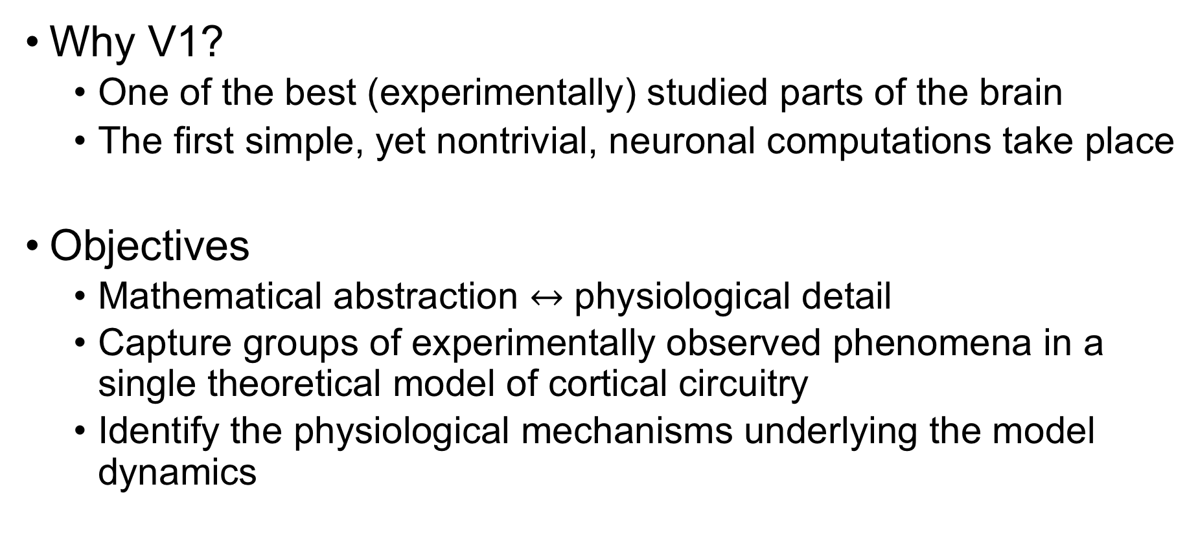
Introduction
Why V1?
One of the best (experimentally) studied parts of the brain
The first simple, yet nontrivial, neuronal computations take place
Objectives
Mathematical abstraction $↔$ physiological detail
Capture groups of experimentally observed phenomena in a single theoretical model of cortical circuitry
Identify the physiological mechanisms underlying the model dynamics

Slide 3
The Evolution of Large-scale modeling of Monkey Primary Visual Cortex, V1: Steps Towards Understanding Cortical Function
Lai Sang Young, Louis Tao, Michael Shelley, Robert Shapley, Aaditya Rangan, and David W. McLaughlin

Slide 4
General model architecture
Large-scale recurrent networks of spiking neurons
Conductance based with high network conductances
Strong synaptic connectivity
Strong nonlinear dynamics
Complicated high-order neuronal interactions
Using experimental anatomical and physiological data to guide the design of models
Using one network, with a fixed architecture and one set of parameters, to model many experiments

Slide 5
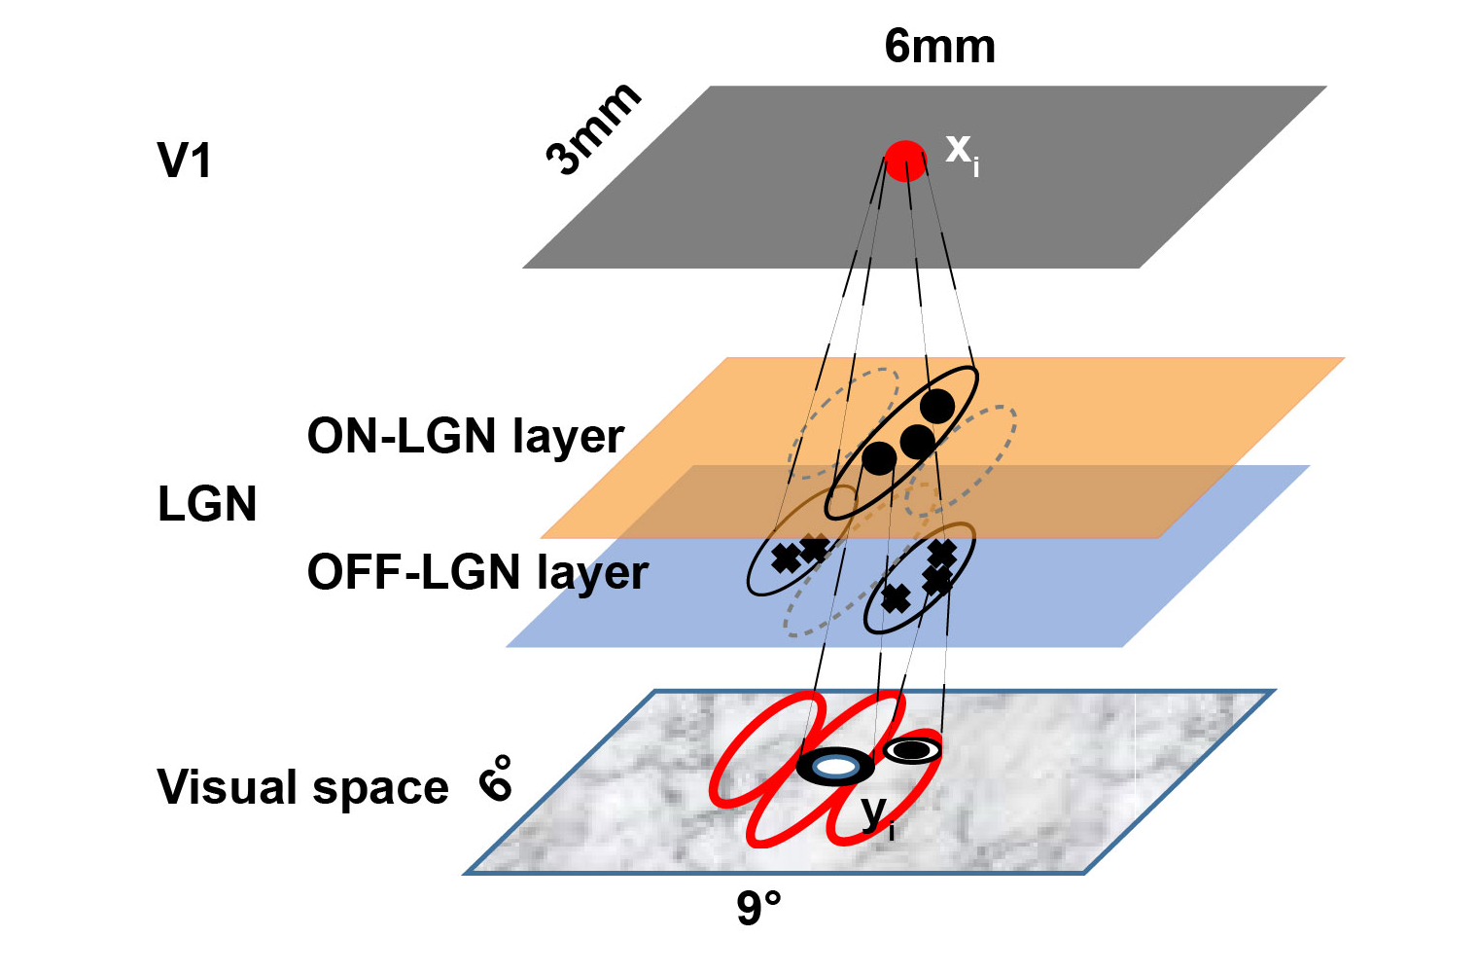
General model architecture

Slide 6
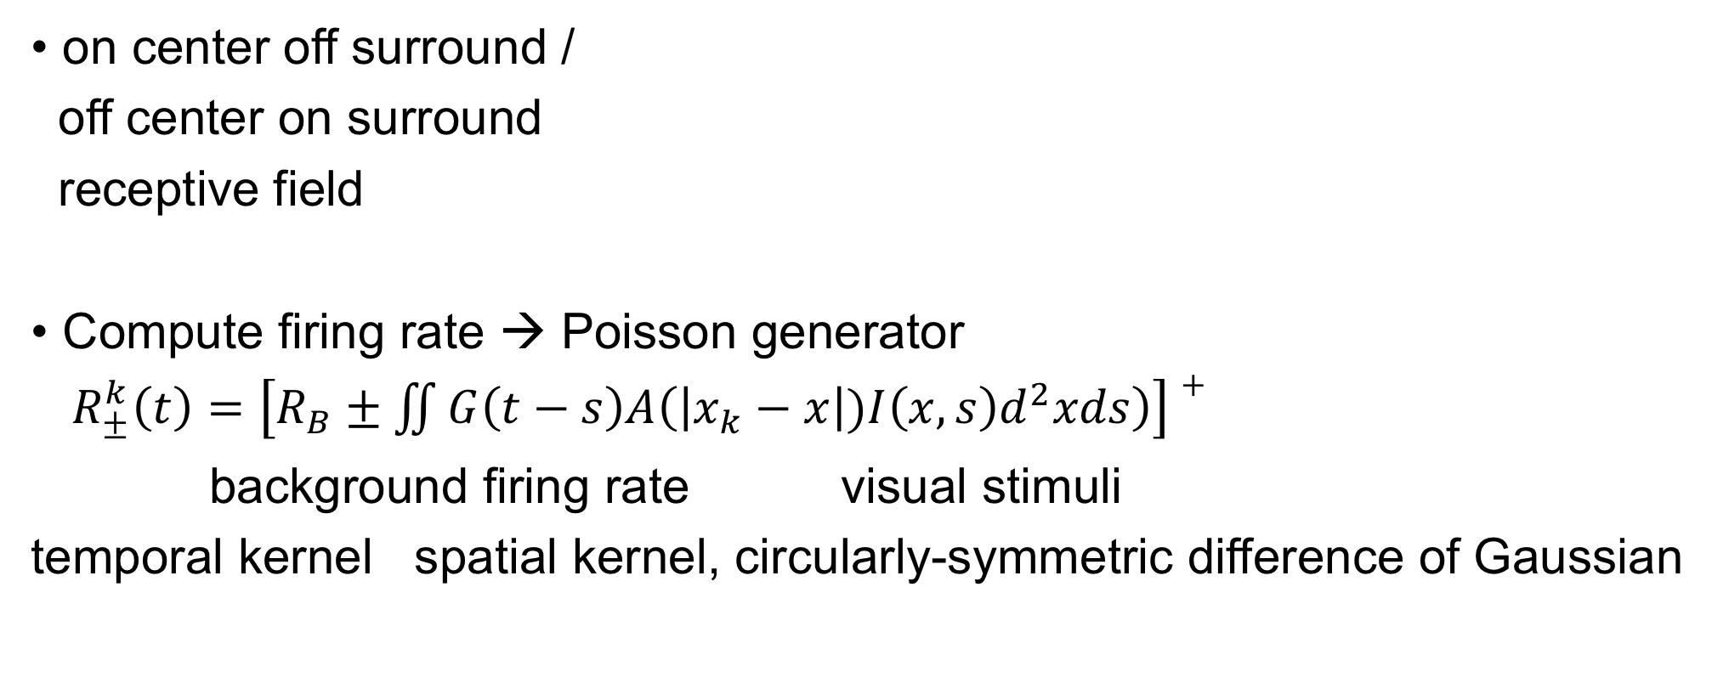
LGN neuron
on center off surround /
off center on surround
receptive field
Compute firing rate → Poisson generator
$R_{±}^{k}\left(t\right)=\left[R_{B}±\iint{G\left(t−s\right)A\left(\left|x_{k}−x\right|)I\left(x,s\right)d^{2}xds\right)}\right]+$
background firing rate visual stimuli
temporal kernel spatial kernel, circularly-symmetric difference of Gaussian

Slide 7
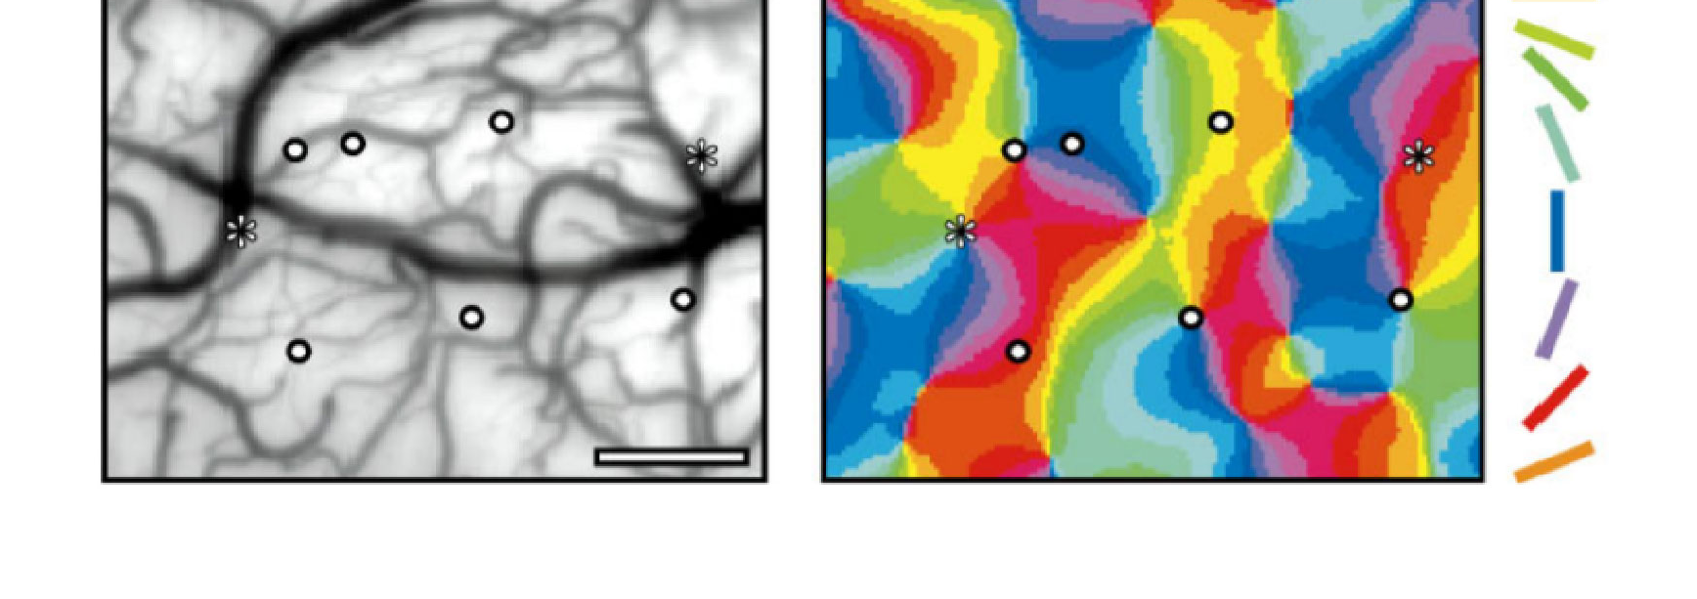
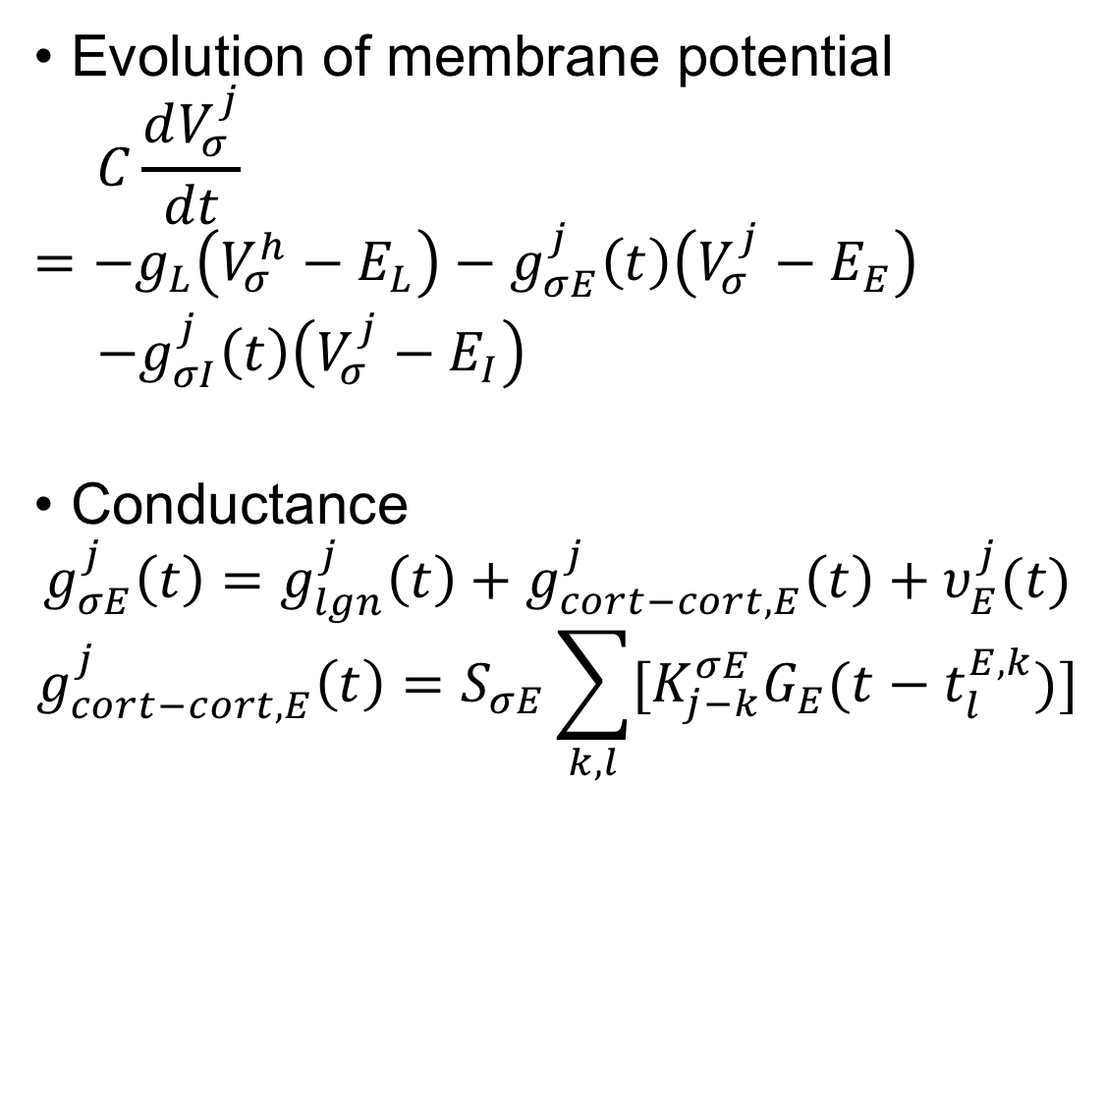
V1 neuron
Gabor receptive field
Pinwheel patterns
Evolution of membrane potential
$$C\frac{dV_{σ}^{j}}{dt}=−g_{L}\left(V_{σ}^{h}−E_{L}\right)−g_{σE}^{j}\left(t\right)\left(V_{σ}^{j}−E_{E}\right)$$
$−g_{σI}^{j}\left(t\right)\left(V_{σ}^{j}−E_{I}\right)$
Conductance
$$g_{σE}^{j}\left(t\right)=g_{lgn}^{j}\left(t\right)+g_{cort−cort,E}^{j}\left(t\right)+υ_{E}^{j}(t)$$
$$g_{cort−cort,E}^{j}\left(t\right)=S_{σE}\sum_{k,l}{[K_{j−k}^{σE}G_{E}(t−t_{l}^{E,k})]}$$

Slide 8
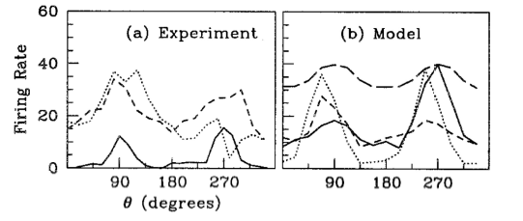
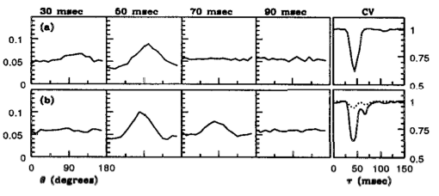
Earliest large-scale V1 model
Q: how does the network cause and shape orientation selectivity, and its distribution over neurons?
A: the dominance of inhibition in the recurrent cortico-cortical activity
Q: can the model explain reverse correlation data on the time course of orientation tuning?
A: yes

Slide 9
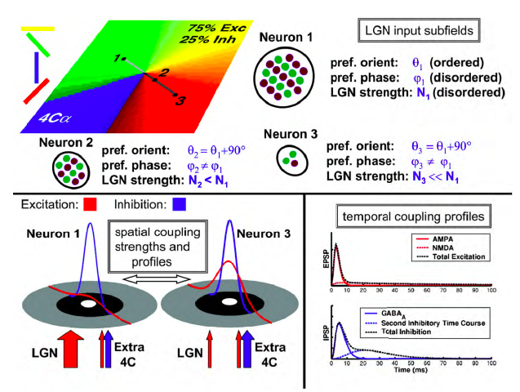
The egalitarian model
Central assumption of Egalitarian model: the total excitation, divided between geniculate and cortical, is roughly constant

Slide 10
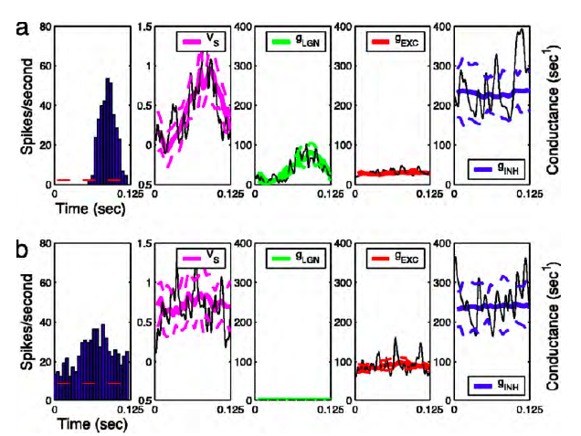
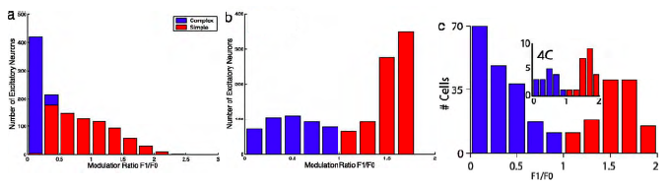
The egalitarian model
Q: how do individual simple and complex cells arise in the network?
A: the trade-off between LGN and cortico-cortical drive
Q: how does the network shape the simple and complex cell distribution in cortex?
A: consequence of highly diverse balance between LGN and cortico-cortical synaptic drives

Slide 11
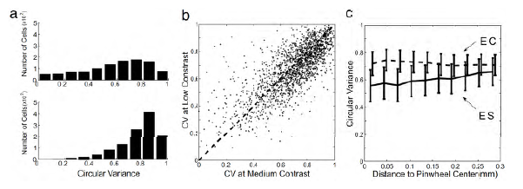
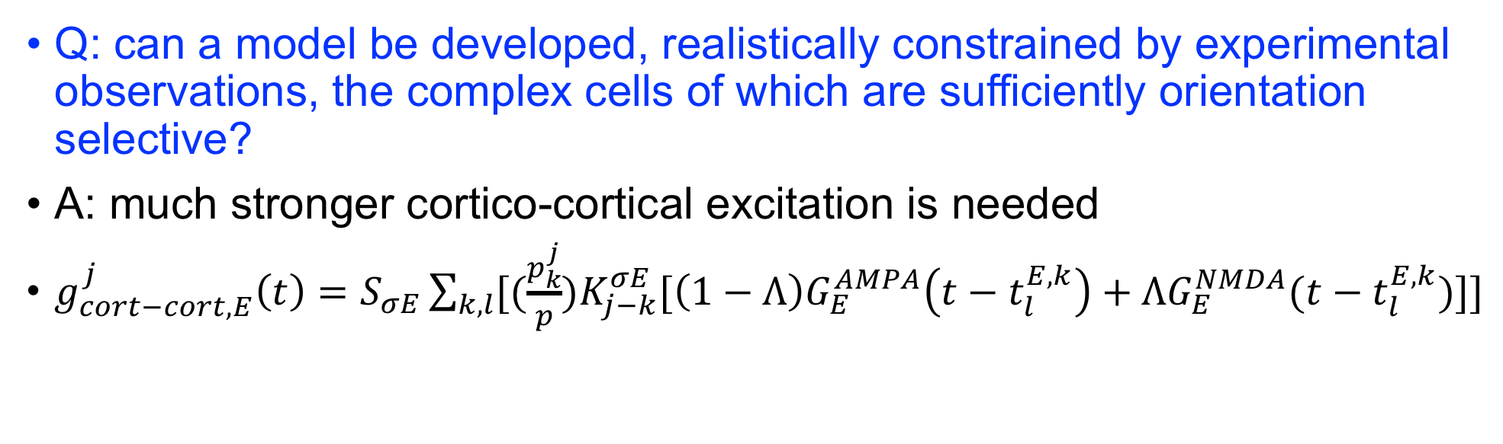
Sparse, high gain model
Q: can a model be developed, realistically constrained by experimental observations, the complex cells of which are sufficiently orientation selective?
A: much stronger cortico-cortical excitation is needed
$g_{cort−cort,E}^{j}\left(t\right)=S_{σE}\sum_{k,l}{[(\frac{p_{k}^{j}}{p})K_{j−k}^{σE}[\left(1−Λ\right)G_{E}^{AMPA}\left(t−t_{l}^{E,k}\right)+ΛG_{E}^{NMDA}(t−t_{l}^{E,k})]]}$

Slide 12
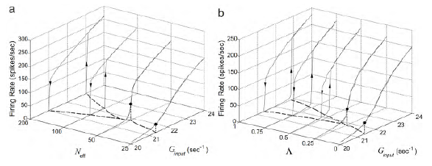
Sparse, high gain model
Q: what are the mechanisms that stabilize the network?
A: a significant increase in the level of intrinsically generated fluctuations
Q: what are the characteristics of the “operating point” or “operating state” of this model cortical network?
A: “high-gain”, just below bistability; large intrinsically generated fluctuations; large conductance; very asynchronous

Slide 13
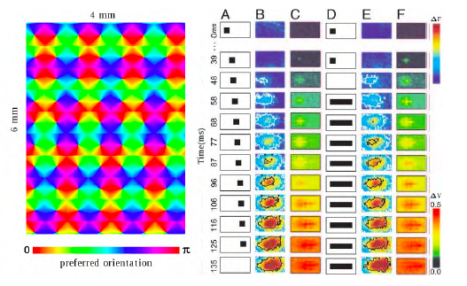
Model of larger cortical patch, with long-range connections
The enlarged model is sufficiently rich to exhibit spontaneous background patterns and preattentive illusory motion
Long-range connections
Slow NMDA-type conductance

Slide 14
The Stabilized Supralinear Network: A Unifying Circuit Motif Underlying Multi-Input Integration in Sensory cortex
Daniel B. Rubin, Stephen D. Van Hooser, Kenneth D. Miller

Slide 15
Overview
Across multiple cortical areas, integration is characterized by two neuronal response properties: surround suppression, normalization
A wealth of integrative properties emerge robustly from four cortical circuit properties:
Supralinear neuronal input/output functions
Sufficiently strong recurrent excitation
Feedback inhibition
Simple spatial properties of intracortical connections

Slide 16
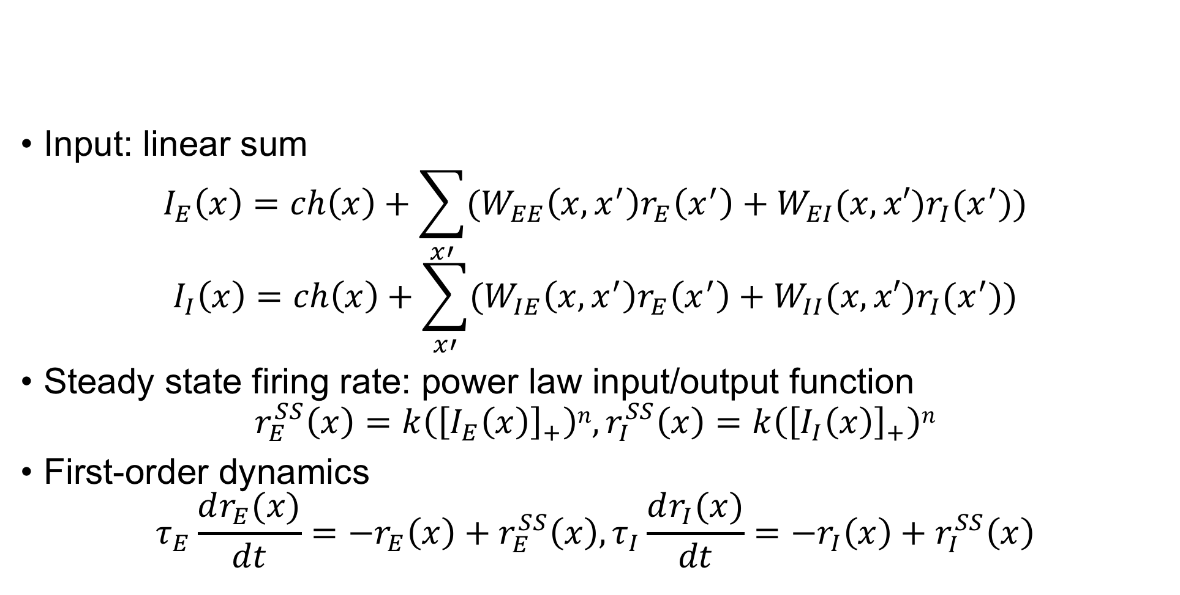
Model details
Input: linear sum
$$I_{E}\left(x\right)=ch\left(x\right)+\sum_{x′}{(W_{EE}\left(x,x^{′}\right)r_{E}\left(x^{′}\right)+W_{EI}(x,x′)r_{I}(x^{′}))}$$
$$I_{I}\left(x\right)=ch\left(x\right)+\sum_{x′}{(W_{IE}\left(x,x^{′}\right)r_{E}\left(x^{′}\right)+W_{II}(x,x′)r_{I}(x^{′}))}$$
Steady state firing rate: power law input/output function
$$r_{E}^{SS}\left(x\right)=k\left({\left[I_{E}\left(x\right)\right]}_{+}\right)n, r_{I}^{SS}\left(x\right)=k\left({\left[I_{I}\left(x\right)\right]}_{+}\right)n$$
First-order dynamics
$$τ_{E}\frac{dr_{E}(x)}{dt}=−r_{E}\left(x\right)+r_{E}^{SS}\left(x\right),τ_{I}\frac{dr_{I}(x)}{dt}=−r_{I}\left(x\right)+r_{I}^{SS}\left(x\right)$$

Slide 17
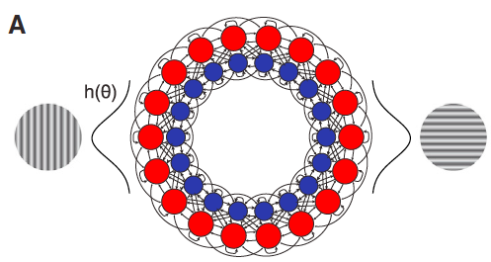
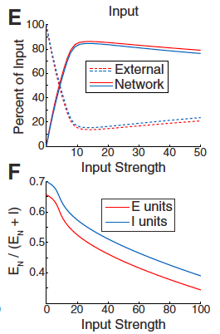
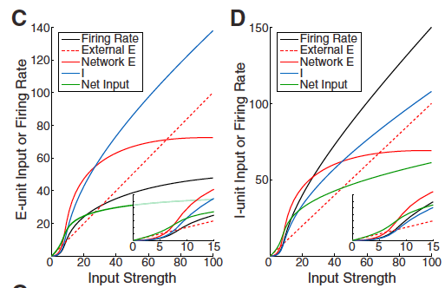
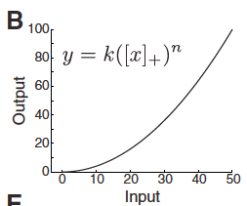
Normalization in a 1D ring model
With increasing strength of single grating stimulus: dominantly externally driven -> dominantly network-driven
Power-law input/output function

Slide 18
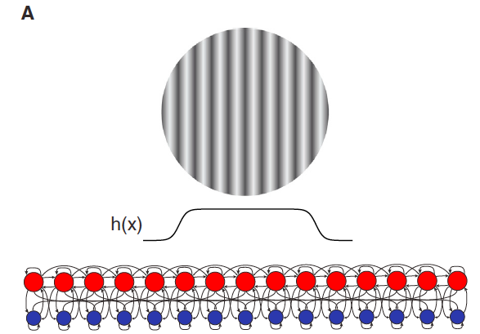
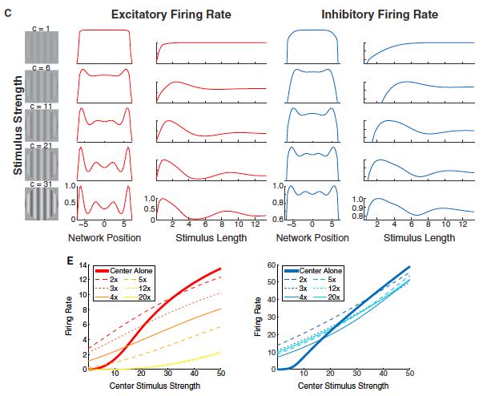
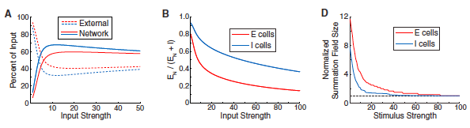
Spatial contextual interactions

Slide 19
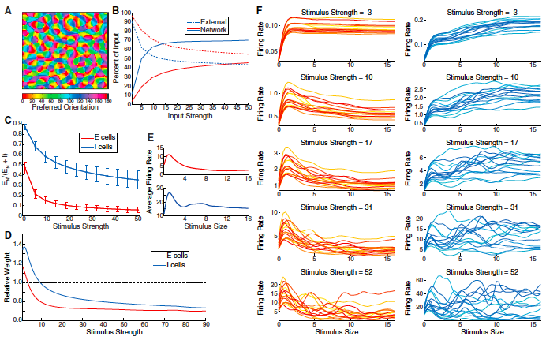
A large-scale, probabilistically connected, 2D model of V1
B: input shifts from externally-driven to network driven
C: network input increasingly inhibition-dominated
D: response summation switches from supralinear to sublinear
E,F: surround suppression and periodicity in length-tuning curves develop

Slide 20
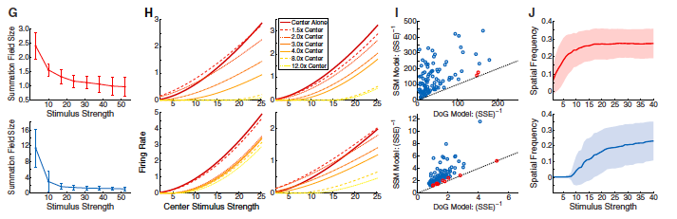
A large-scale, probabilistically connected, 2D model of V1
G: summation fields shrink H: for weak center input strength, surround suppression weakens, and for smaller surrounds, can switch to surround facilitation I: the periodicity in both length- and position-tuning curves is statistically significant J: preferred CM SF increases with stimulus strength

Slide 21
Discussion
The model depends on very few assumptions, most importantly a suparlinear I/O function for single neurons and sufficiently strong recurrent excitation and feedback inhibition
Experimental predictions
Extension to other cortical properties
Inhibition stabilized network

